Slide 1
FINAL TERM PROJECT OBJECT ORIENTED ANALYSIS AND DESIGN
SUBMITTED BY:
NAME: MAHZABIN MOSTARY ID:18-38606-2
NAME: UMMA KHADIZA ID:18-38311-2
NAME: HASSAN KH SALAR ID: 18-38615-2

Slide 2
PROJECT NAME: AIUB ADMISSION MANAGEMENT SYSTEM
WE WILL SHOW OUR PROJEC WITH SOME UML DIAGRAM
USE CASE DIAGRAM
CLASS DIAGRAM
SEQUENCE DIAGRAM
STATE CHART DIAGRAM
ACTIVITY DIAGRAM

Slide 3
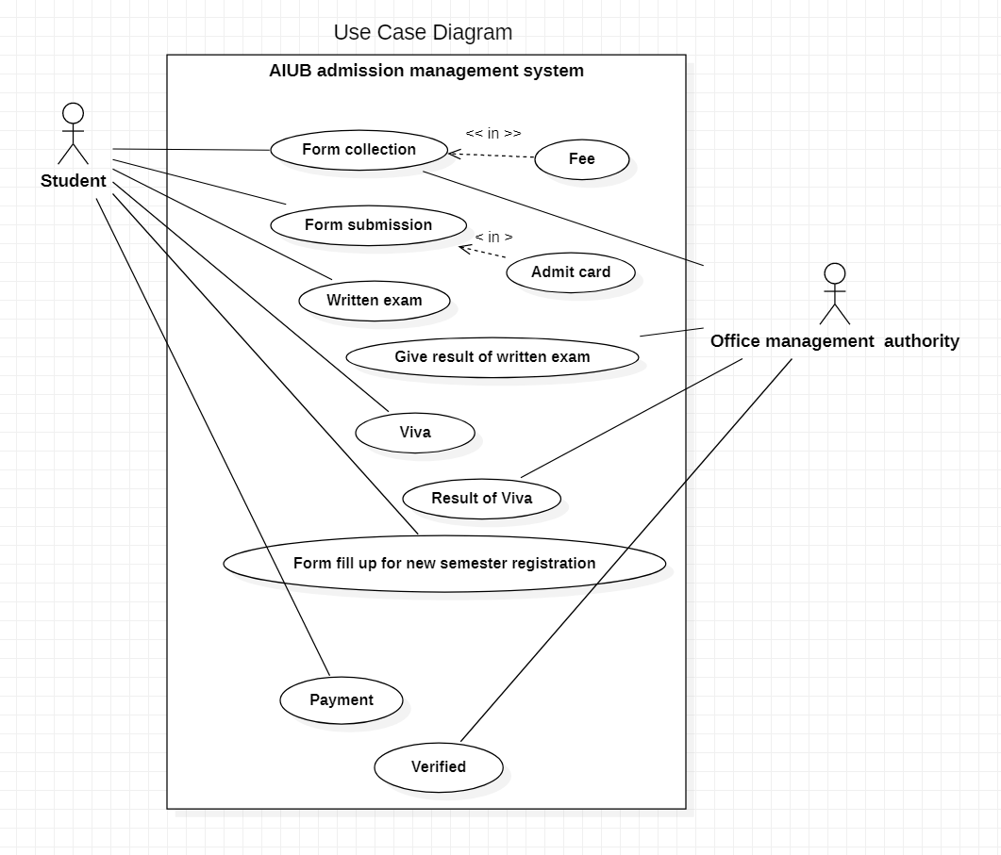
use case Diagram

Slide 4
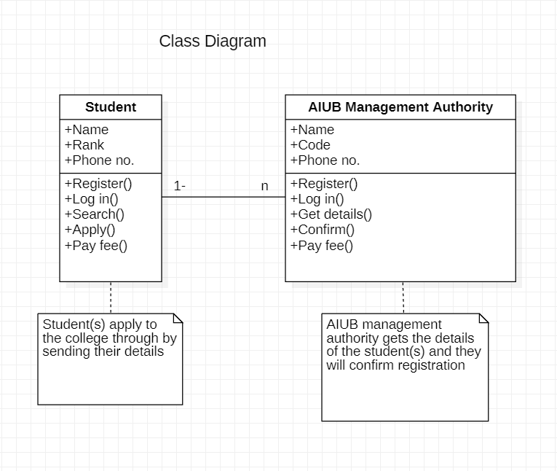
Class Diagram

Slide 5
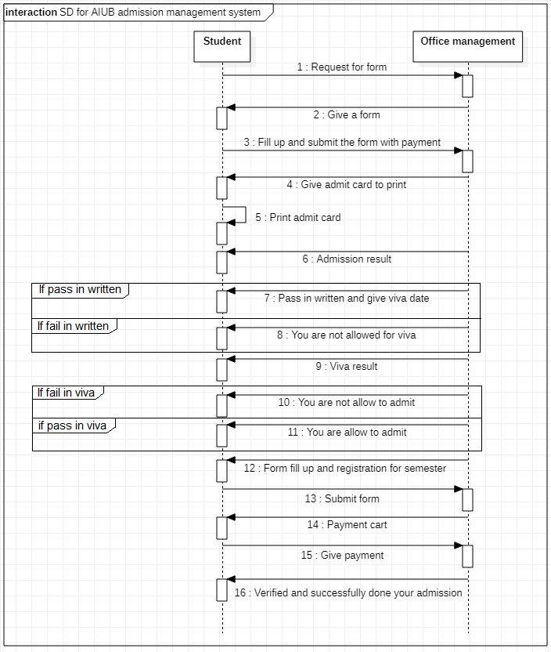
1.sequence diagram

Slide 6
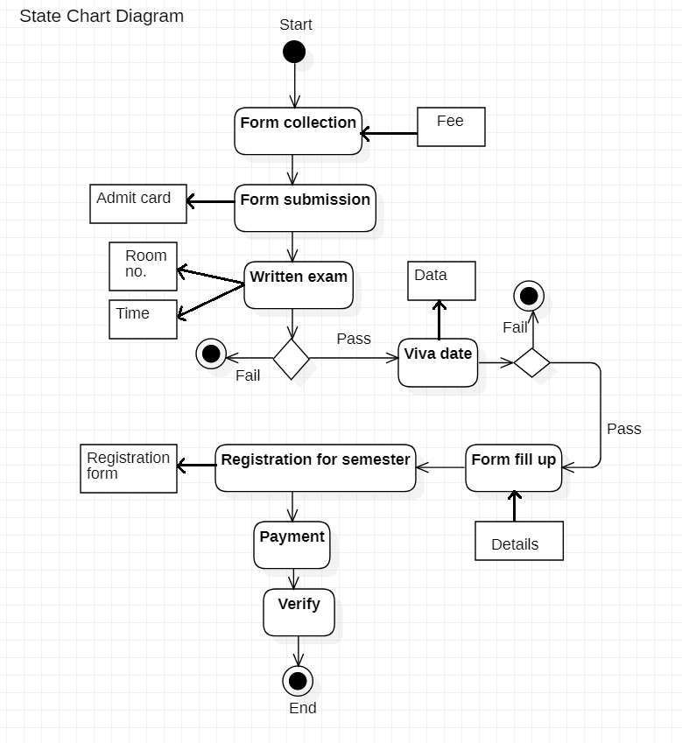
2.state chart diagram

Slide 7
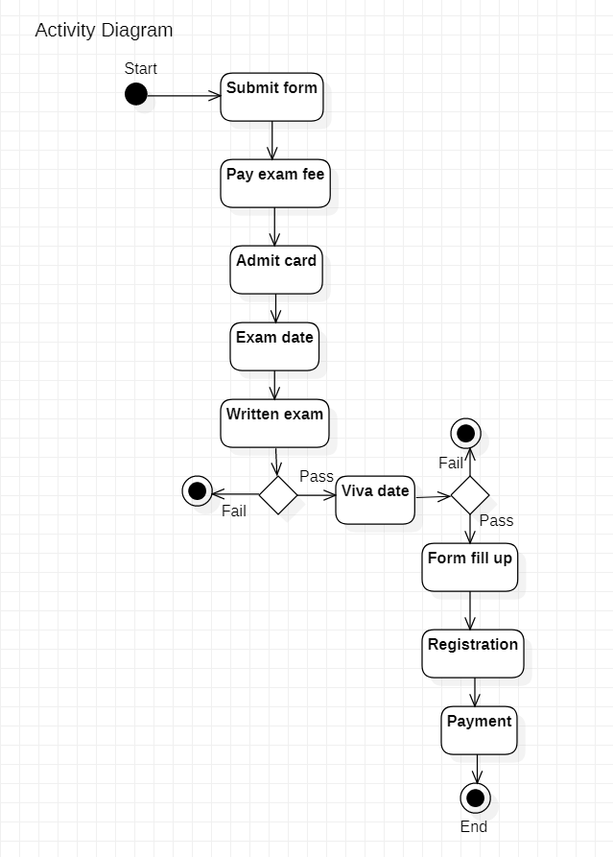
Activity Diagram

Slide 8
we showed five types UML diagram in ous previous slides.
now we will discuss our over all design with use case diagram
USE Case Title : AIUB Admission management system
Author: MAHZABIN
Actor : AIUB Authority
Date: 07-04-2020
Purpose: TO admit AIUB.
PRE Condition: 1. AIUB must have to give a circular for admissiob test.
2.There will have some requirement like SSC/HSC/ O- Level/A-level minimun points, passing year of SSC/HSC/O-level/A-level exam etc.

Slide 9
OVER ALL VIEW: This diagram is based on AIUB admission management system. Here author is student and actor is AIUB management authority . First of all a student have to collect a form. Then she wii submit the form will fee. then she will get a admit card with date of exam and venu of the admission test exam. after attending the exam she will get a result of exam test. If she passes at the exam then will call her university for viva exam. if she cannot pass at the written exam she will not abal to admit at AIUB. then afterviva if she can pass then she will perfectly able to admit the university. if she cannot pass in the viva exam, she will not be able to admit in the university. then who is selected for viva she will registration for semester. then she will be pay semester fee. then she will be verified. then finally she will be student of AIUB.

Slide 10
THANK YOU

